Slide 1


Pneumonia Diagnostic Infrastructure
Submitted by:
Nachiketa Buddha (17DCE004)
Devanshu Gupta (17DCE011)
Kamal Kakadiya (17DCE021)
Rohan Mehta (17DCE027)
Aditi Patel (17DCE038)
Internal Guide:
Asst. Prof. Hardik Jayswal
Department of Computer Engineering, DEPSTAR

Slide 2
Problem Statement
Presented here is an IoT enabled Pneumonia Diagnostic Infrastructure which monitors parameters like Respiration Rate, Heart Rate, Blood Oxygenation Level and Body Temperature on your smartphone using our mobile application, website and a working prototype.

Slide 3
Proposed System and Scope of System
A hardware model which collects the data about the parameters and reflection of it on application and web portal.
High mortality rate when it comes to children below 5 years of age suffering from viral Pneumonia.

Slide 4
Requirement Gathering Techniques
Brainstorming
Document Analysis
Interface Analysis
Prototyping
Reverse Engineering

Slide 5
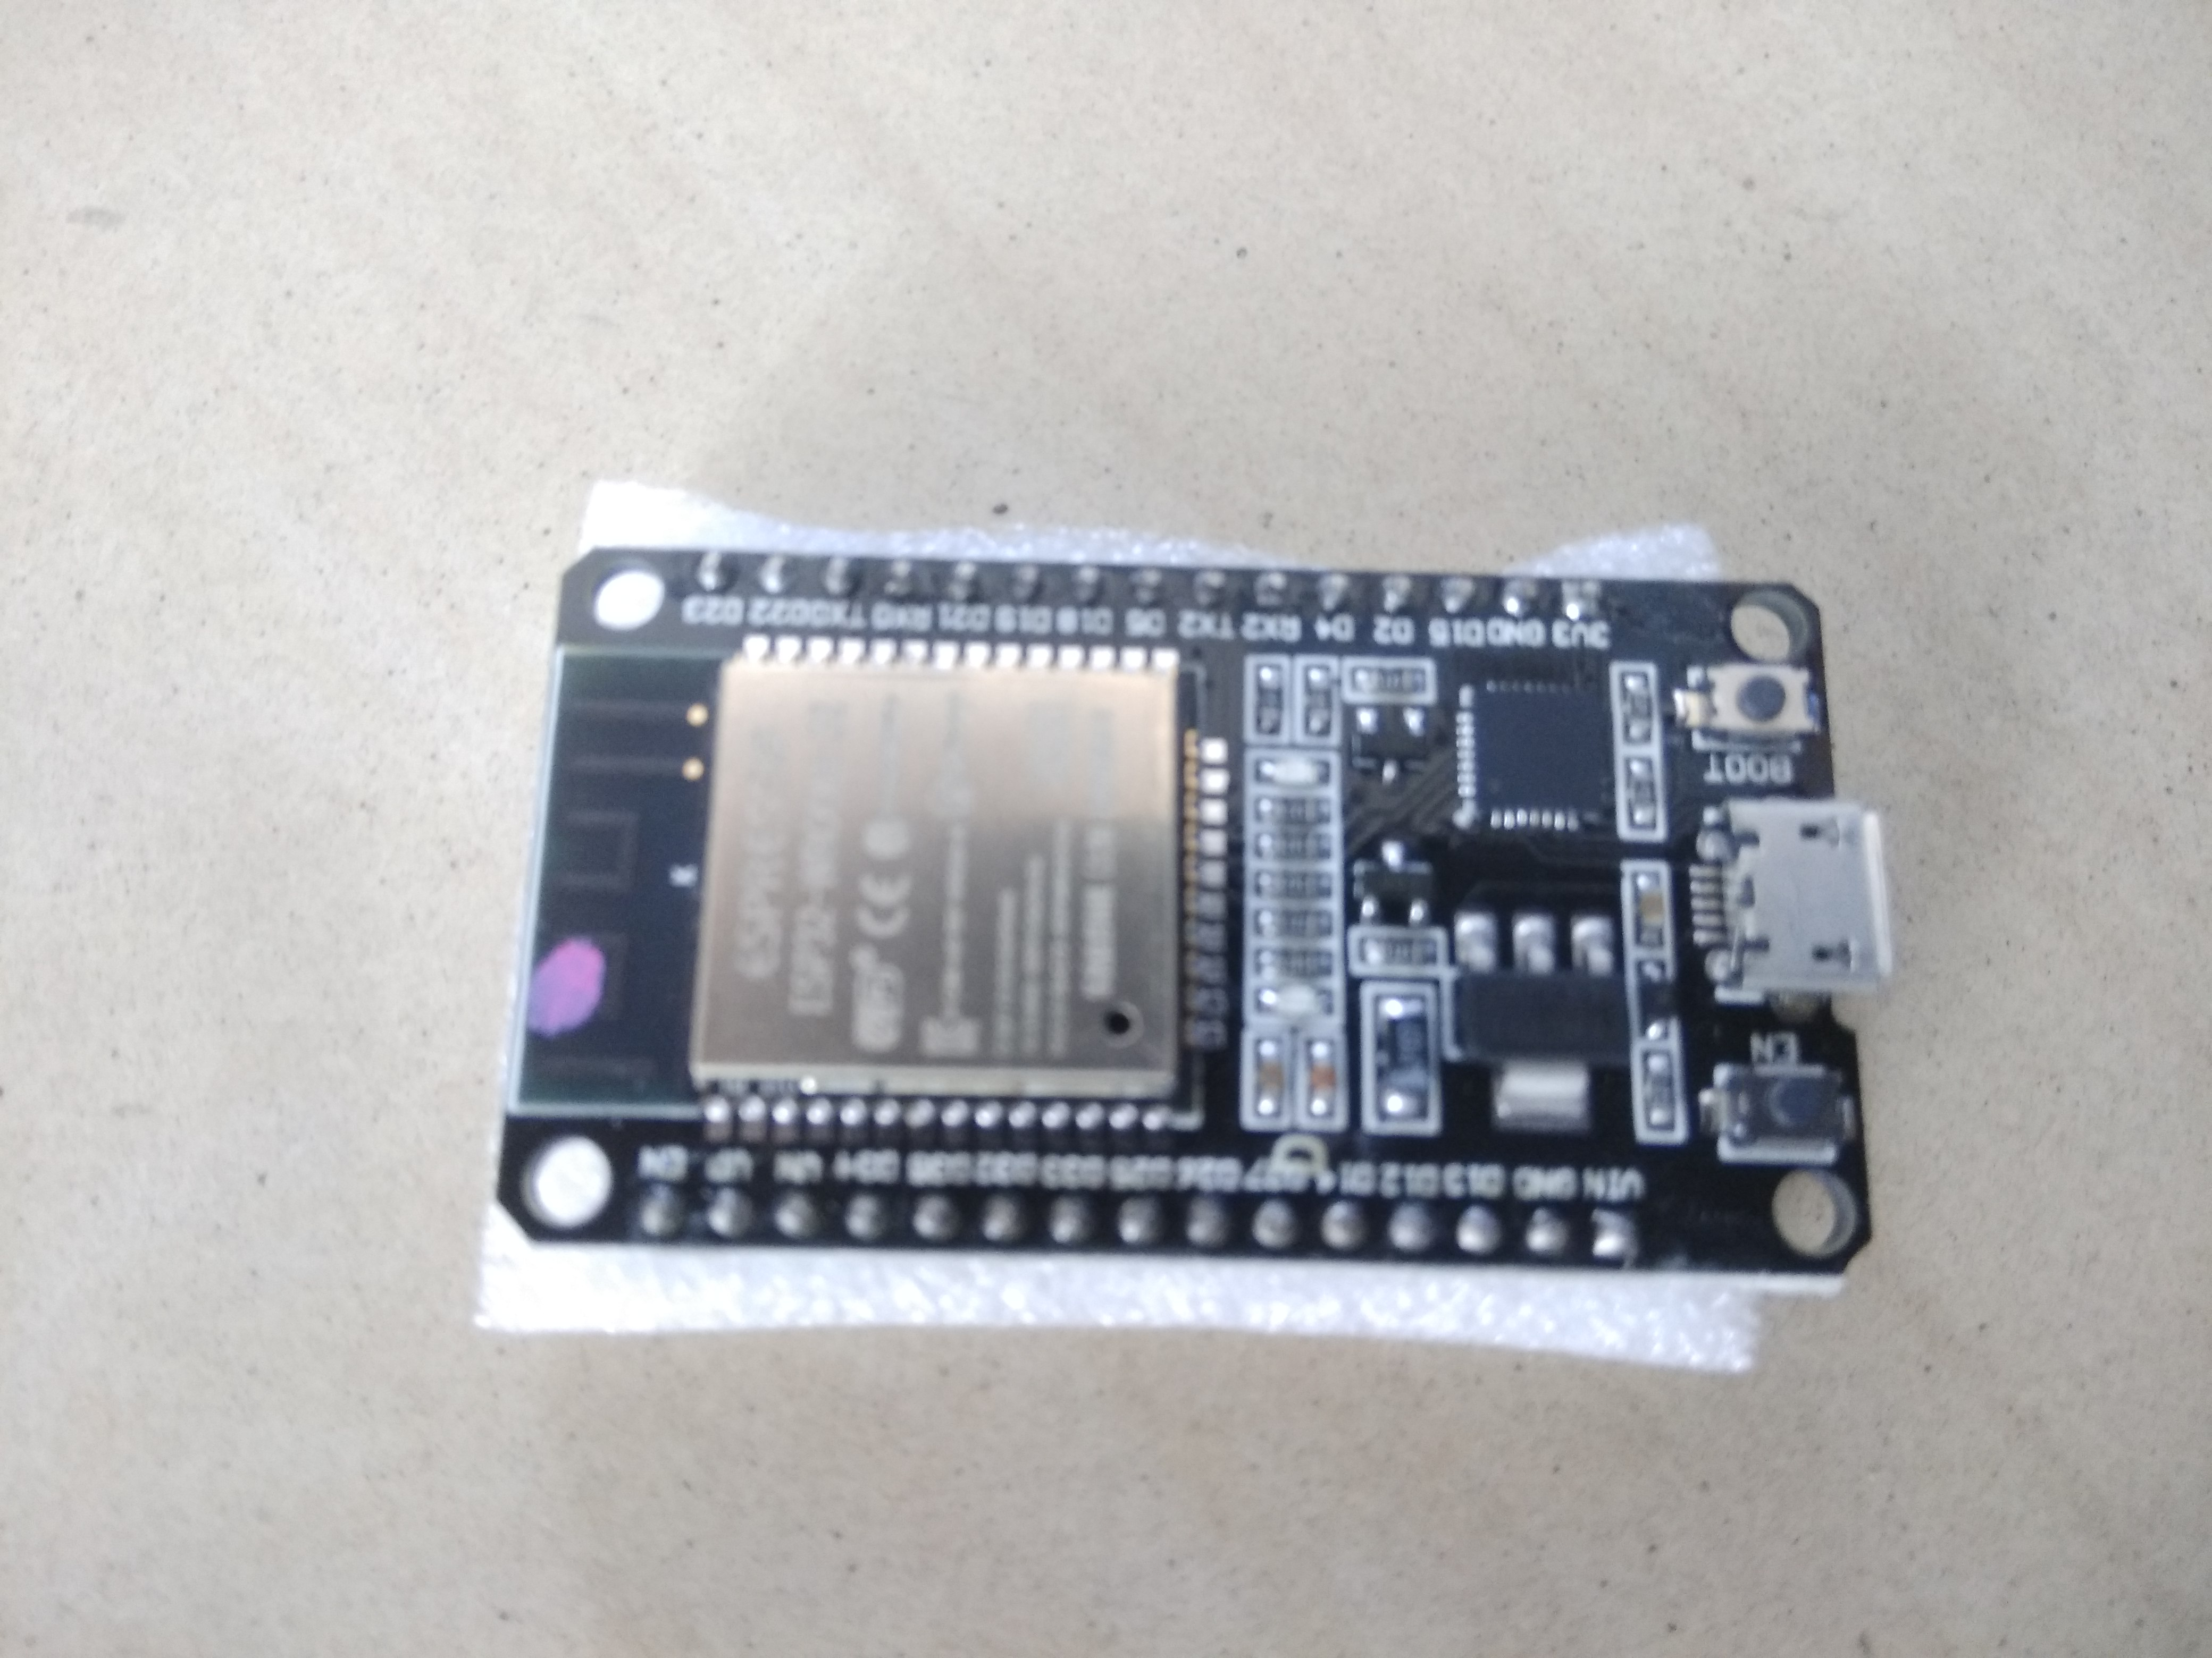
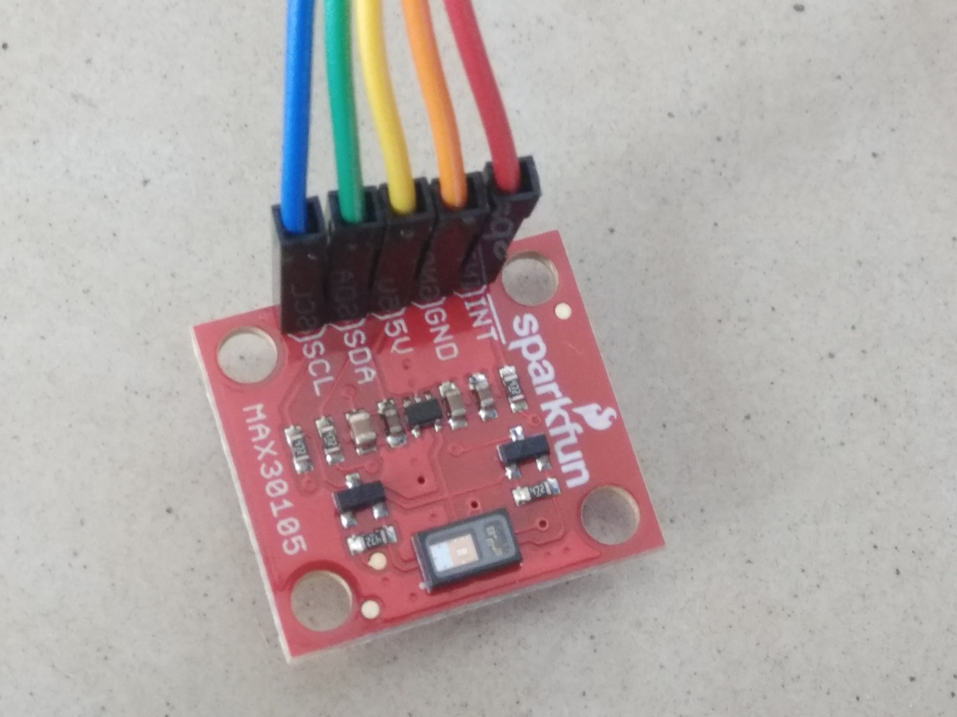
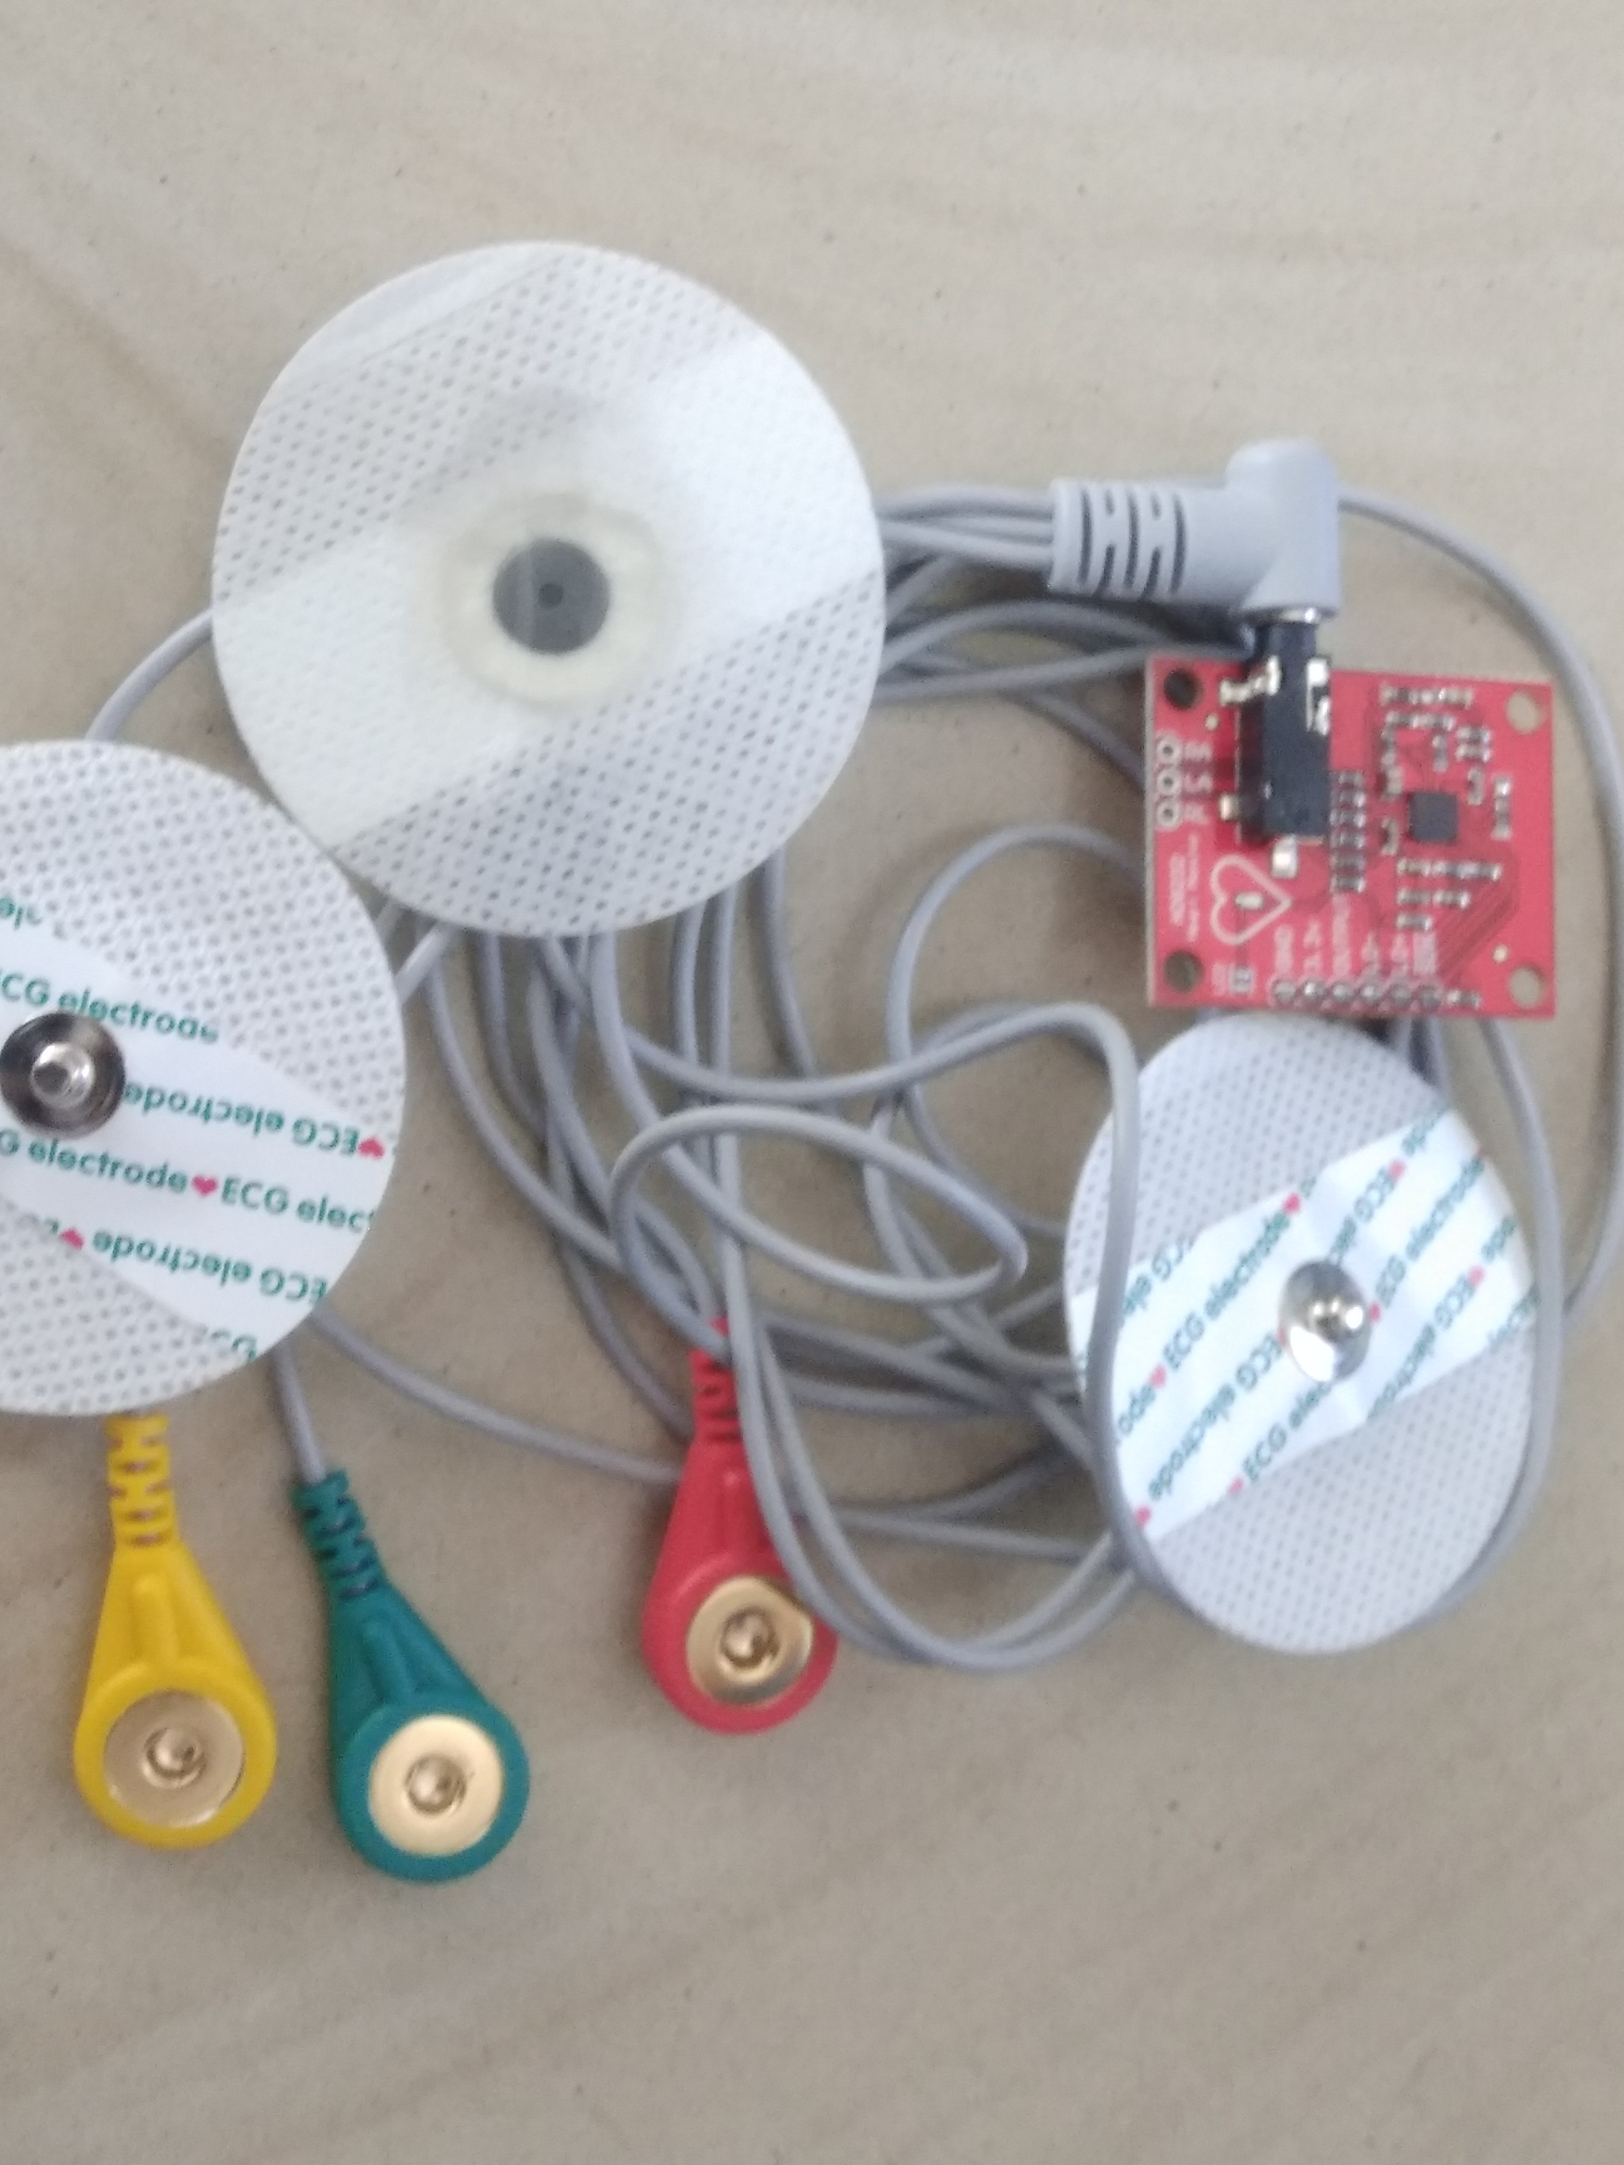
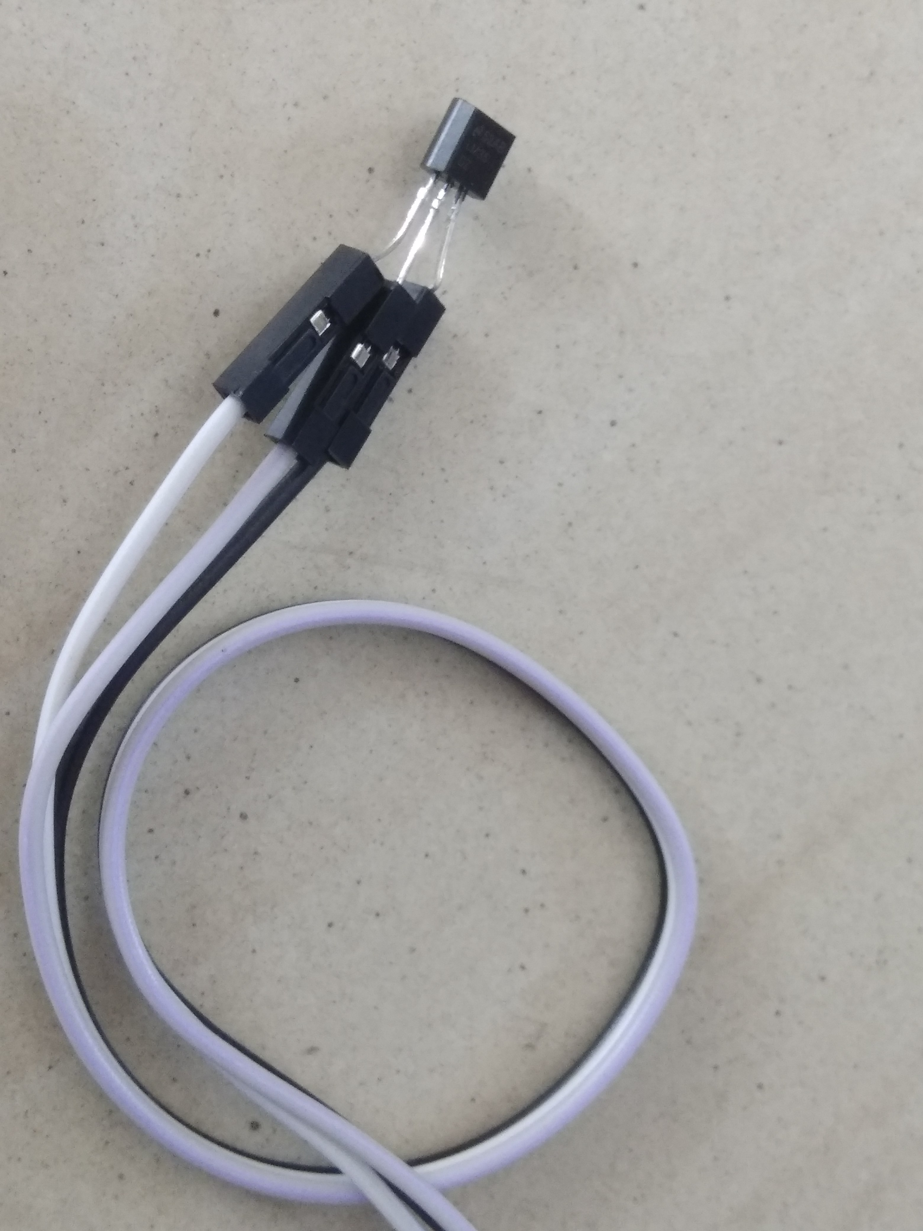
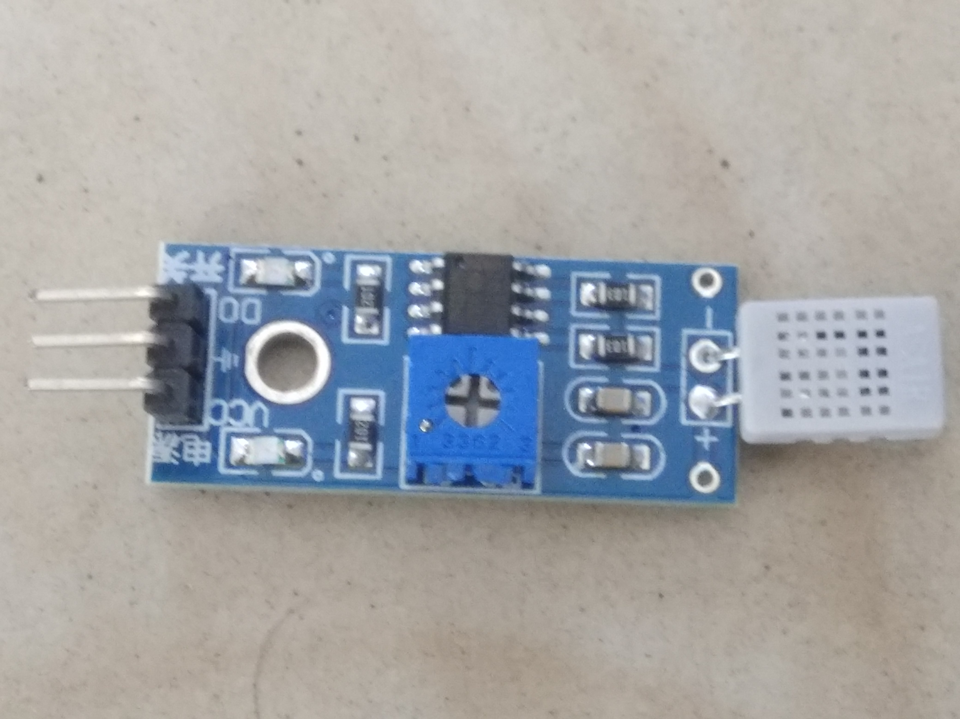
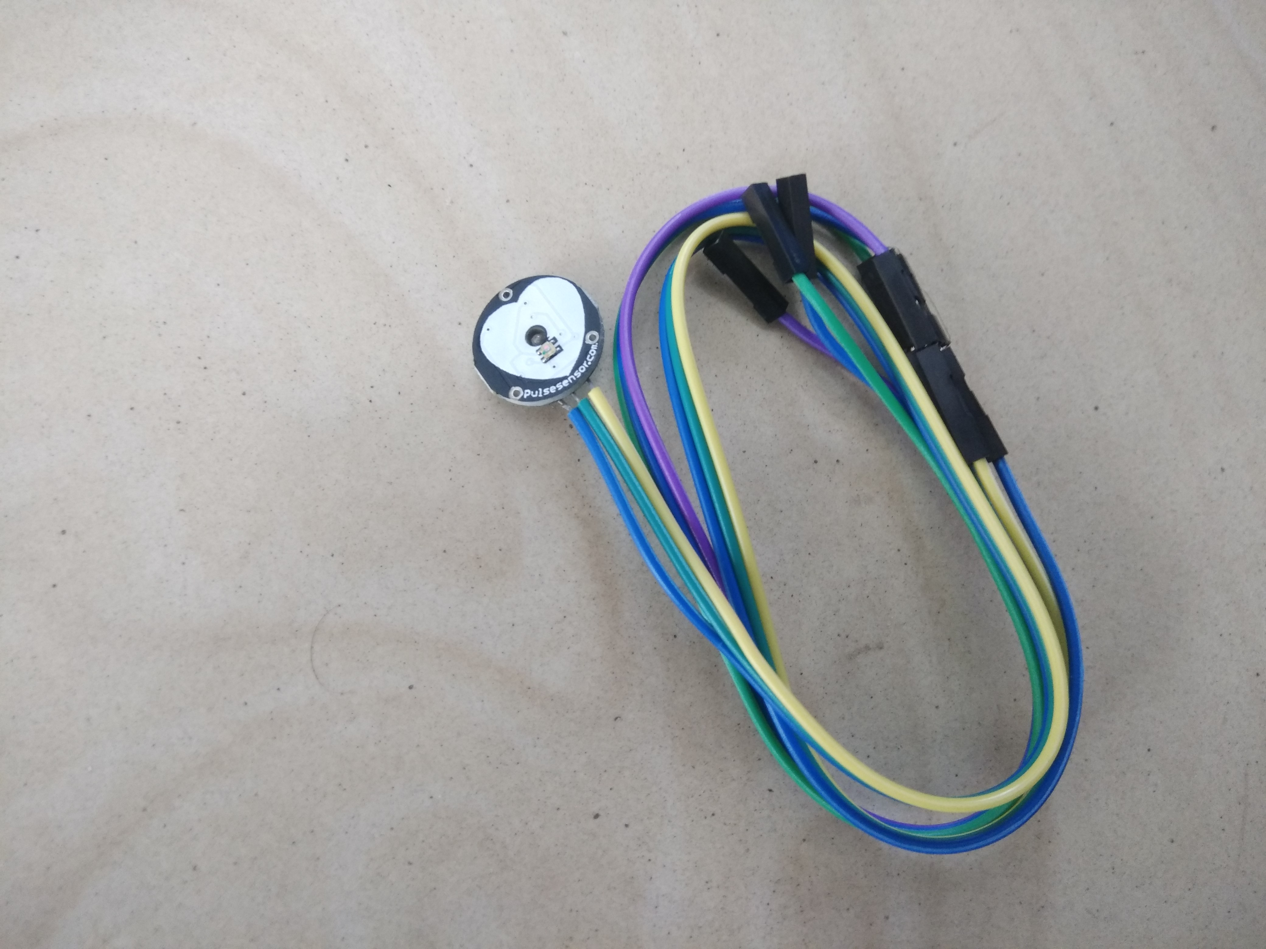
Hardware Requirements
Microcontroller ESP32
Pulse Oximeter MAX30105
ECG Sensor AD8232
Temperature Sensor LM35
Humidity Sensor HR202
Heart Rate Sensor PLSNSR1

Slide 6



Software Requirements
Software :
Android (Above version 5.0: Lollipop)
iOS 6 and above powered apple device
Any standard web browser

Slide 7
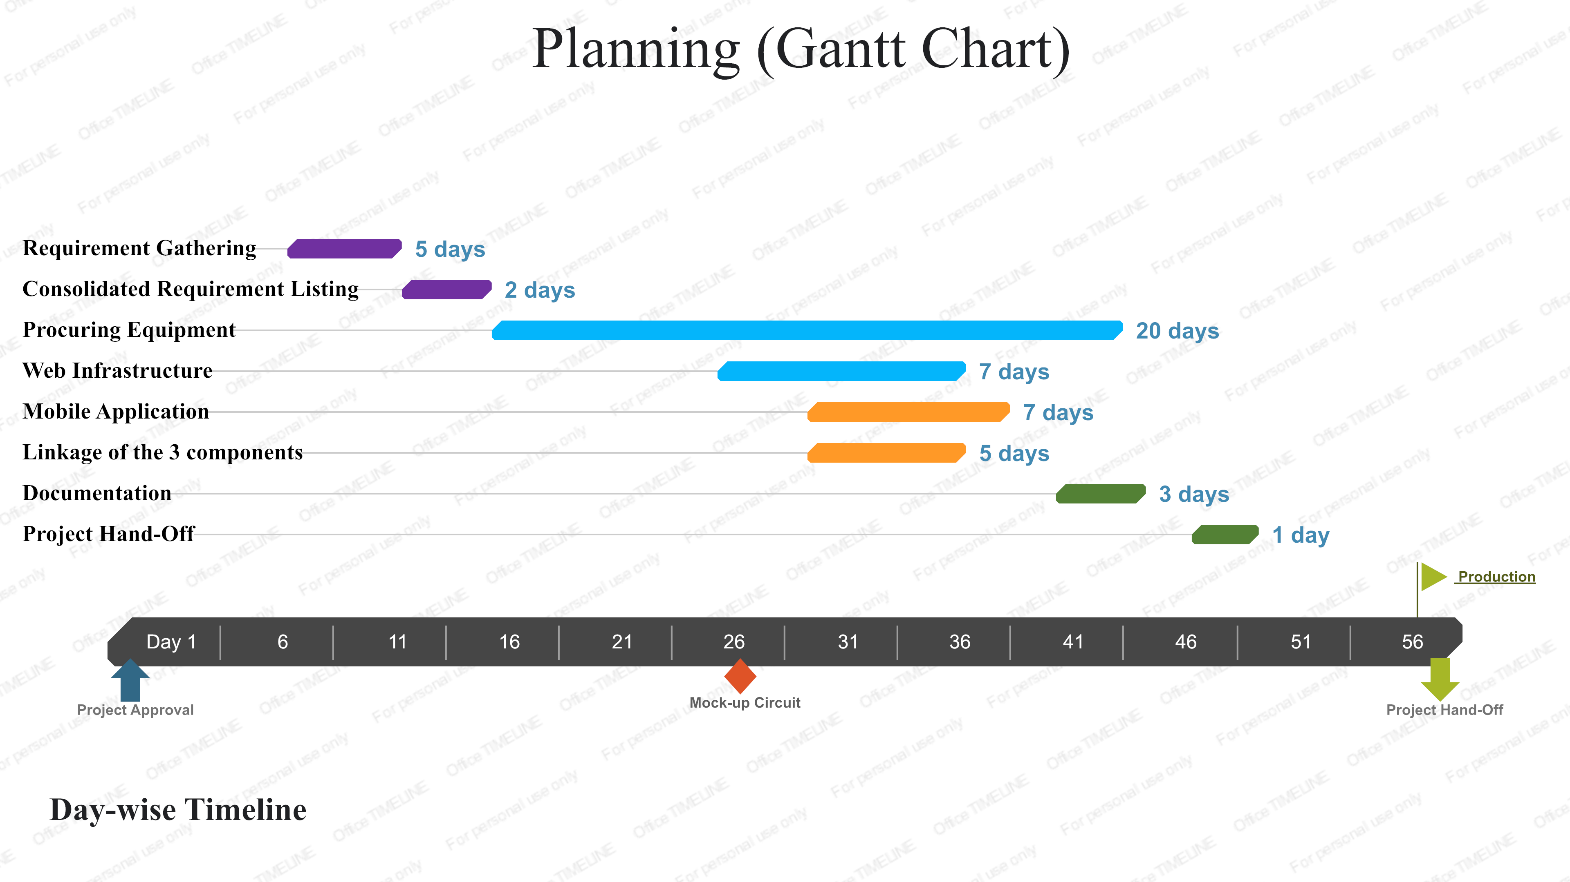
Gantt Chart

Slide 8
Connectivity Flow

Slide 9
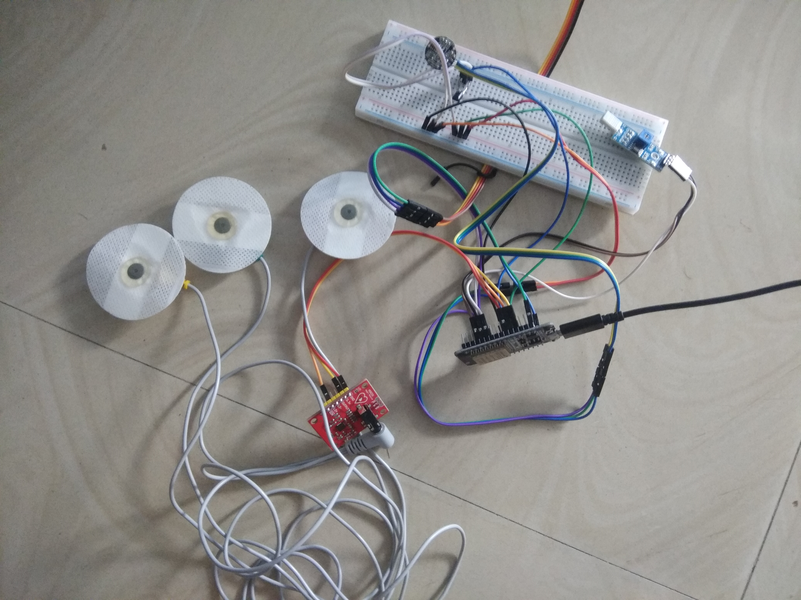
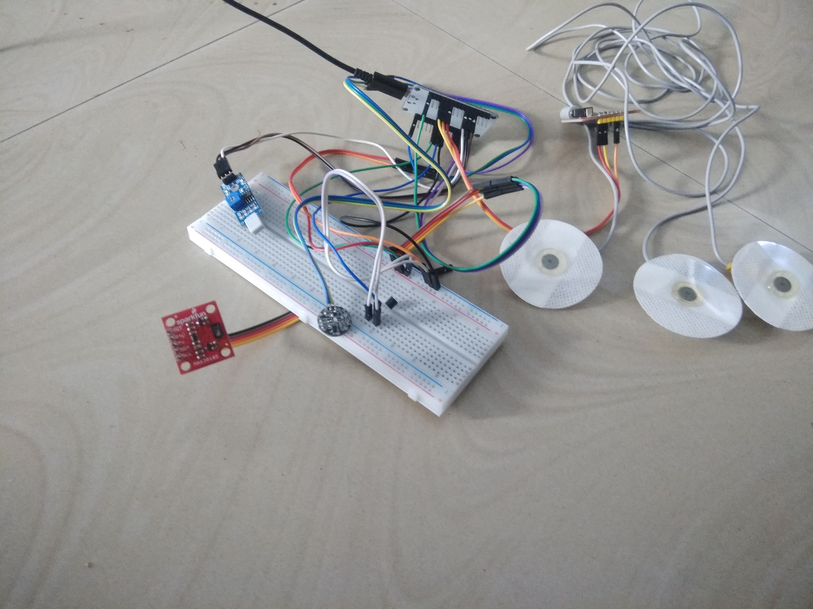
Circuit & Hardware Implementation

Slide 10
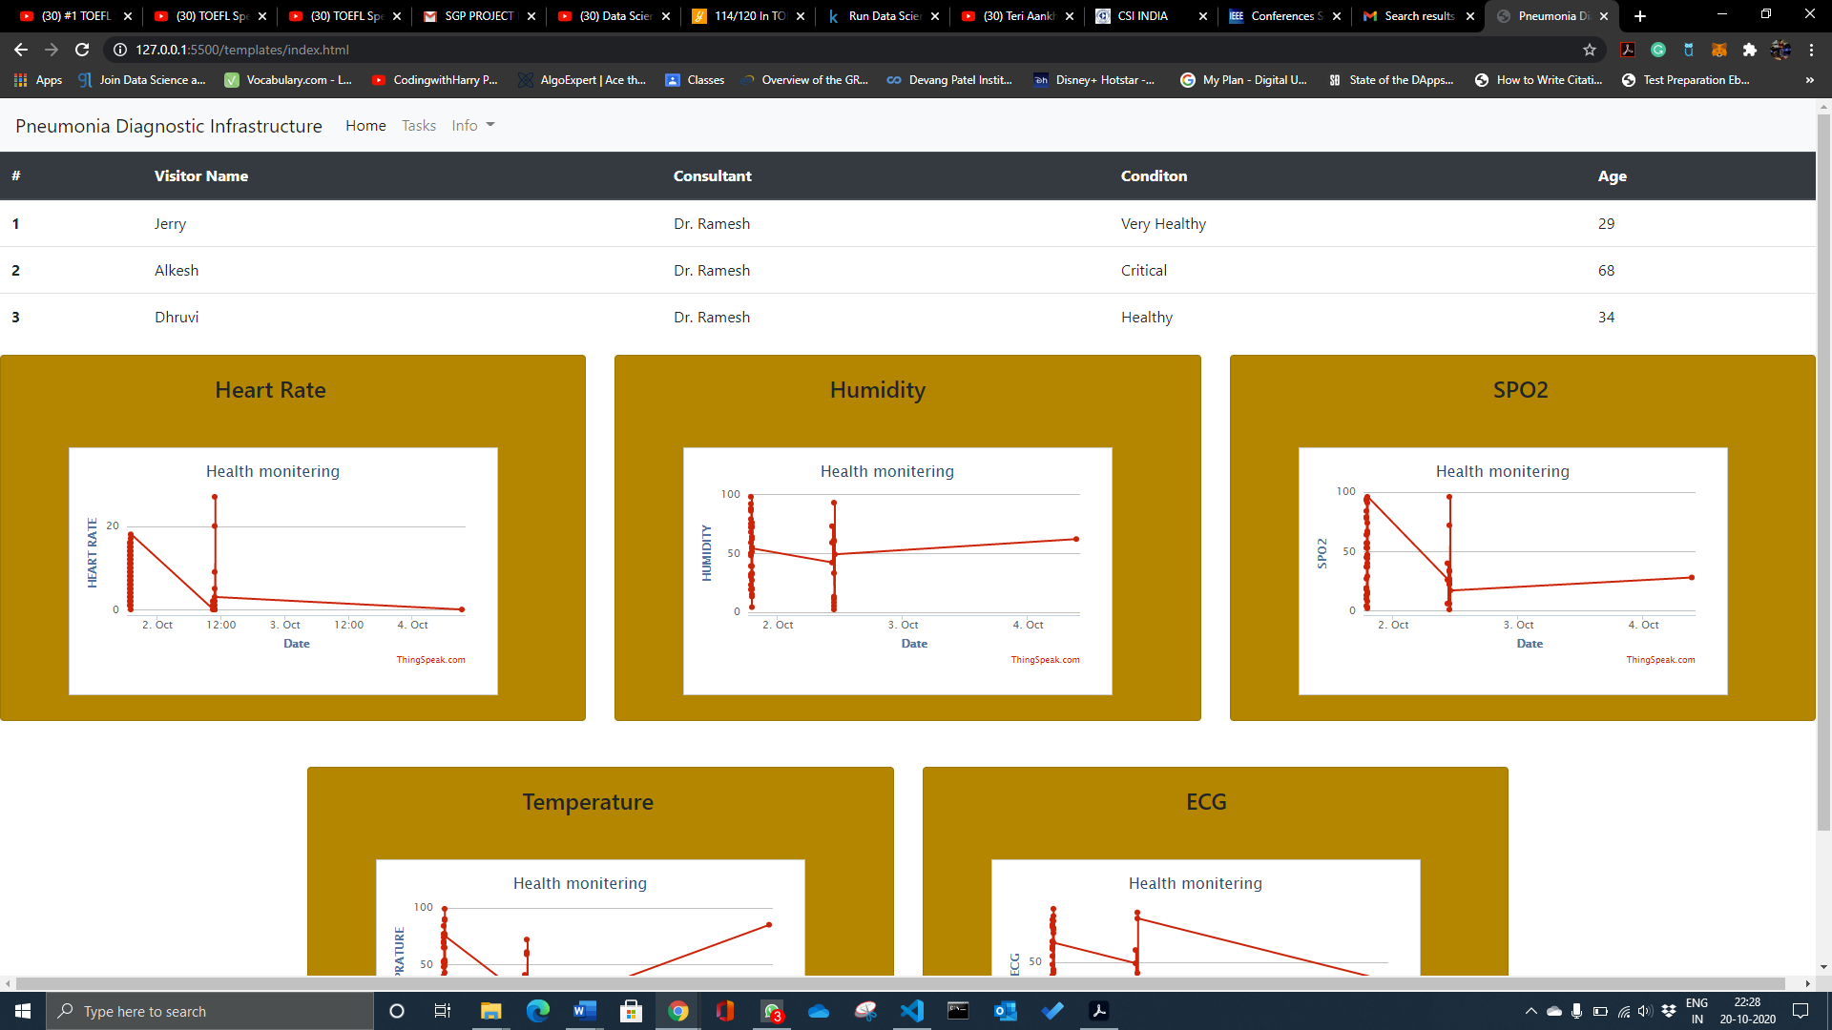
Implementation: Website Snapshots

Slide 11
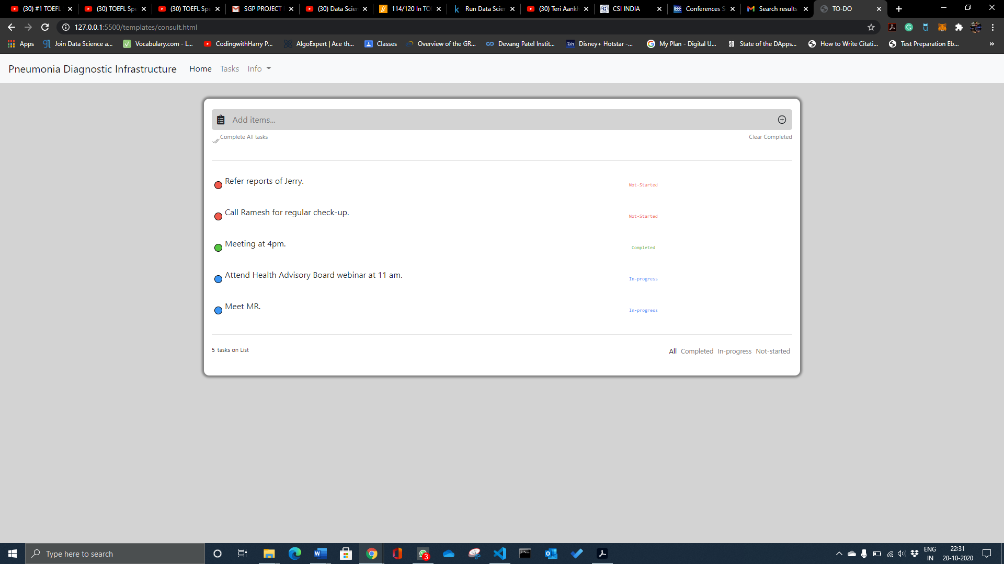
Contd..

Slide 12
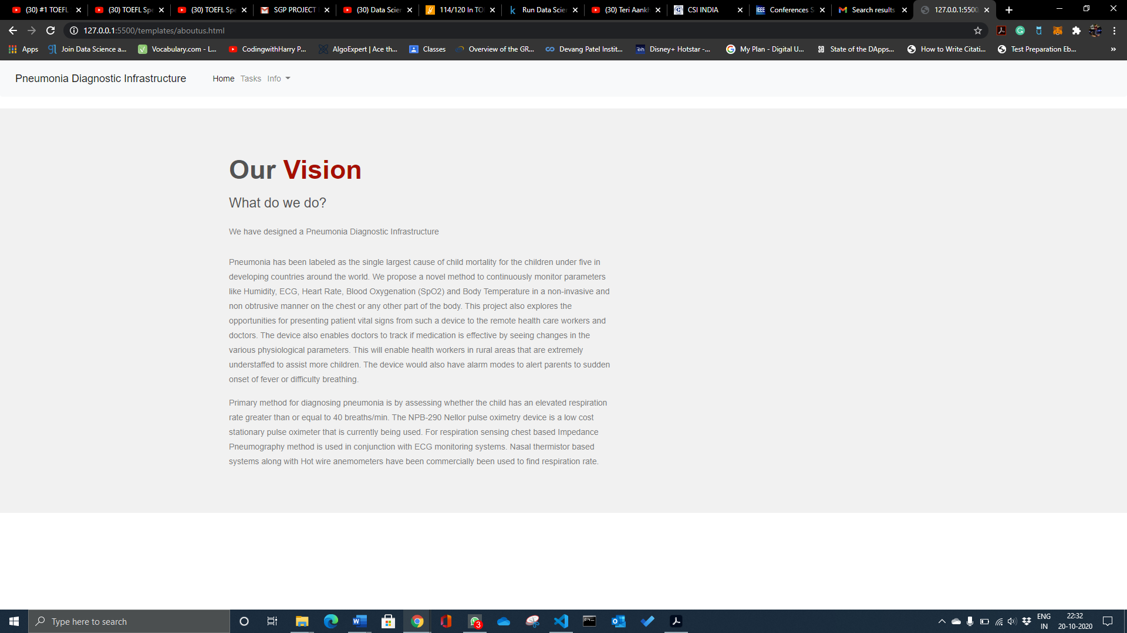
Contd..

Slide 13
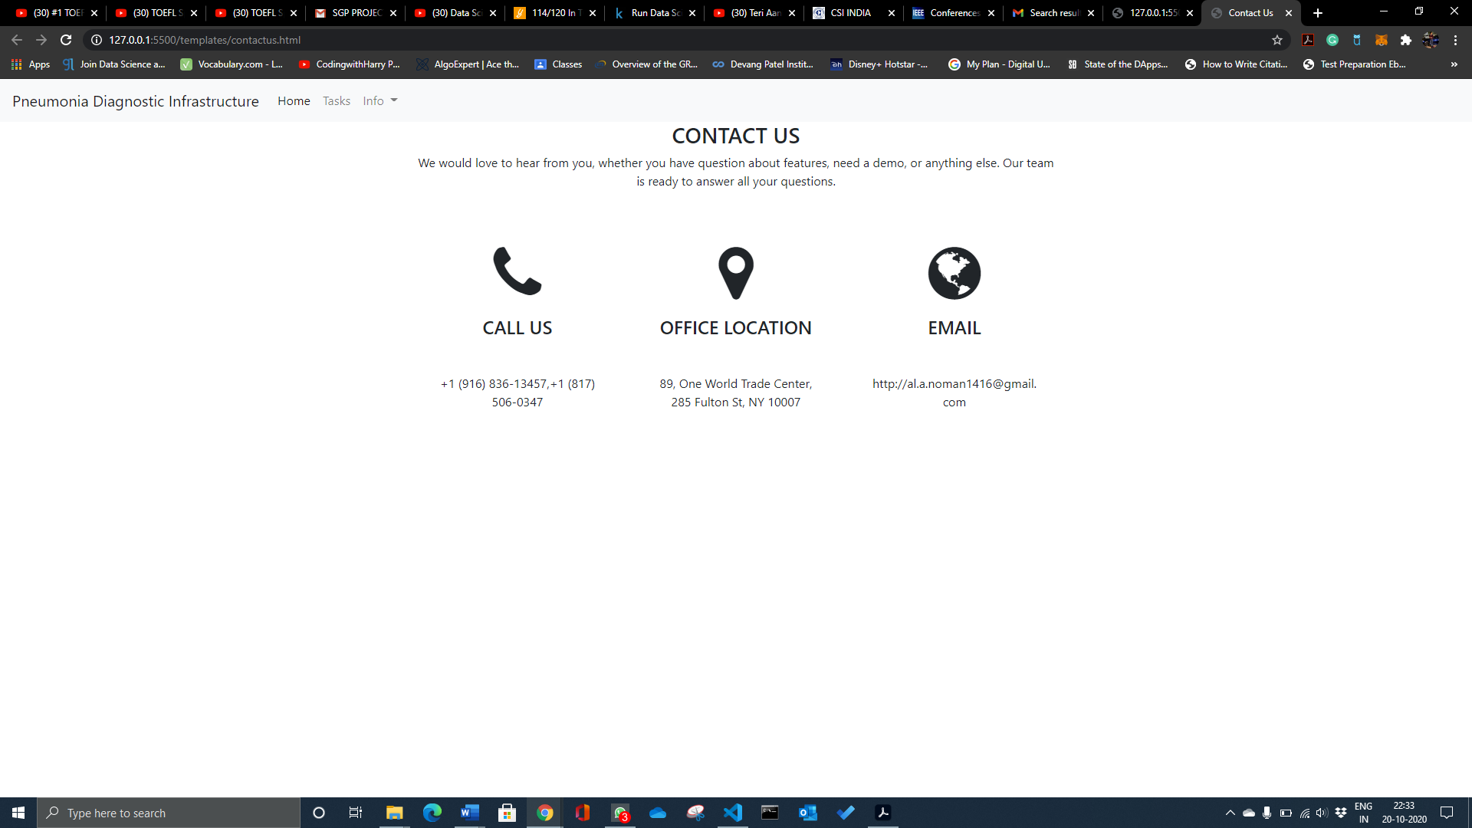
Contd..

Slide 14
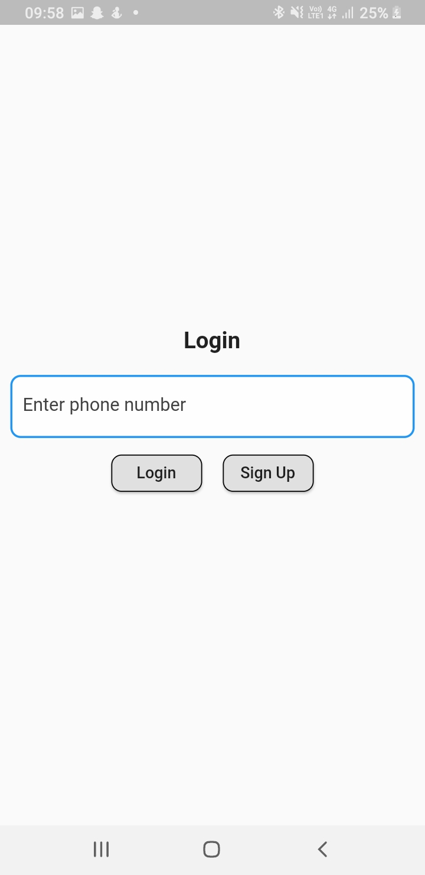
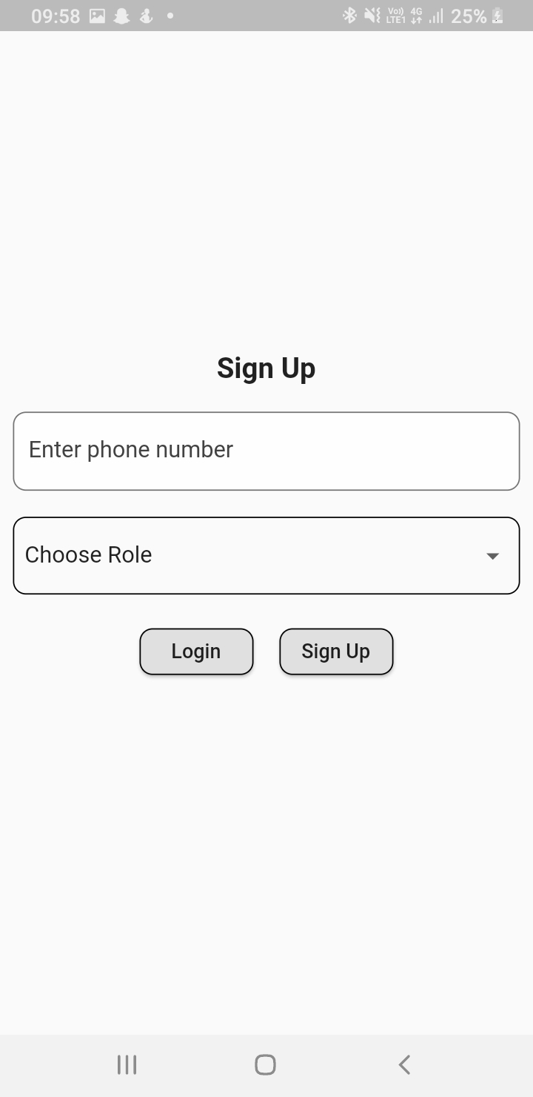
Implementation: Mobile Application Snapshots

Slide 15
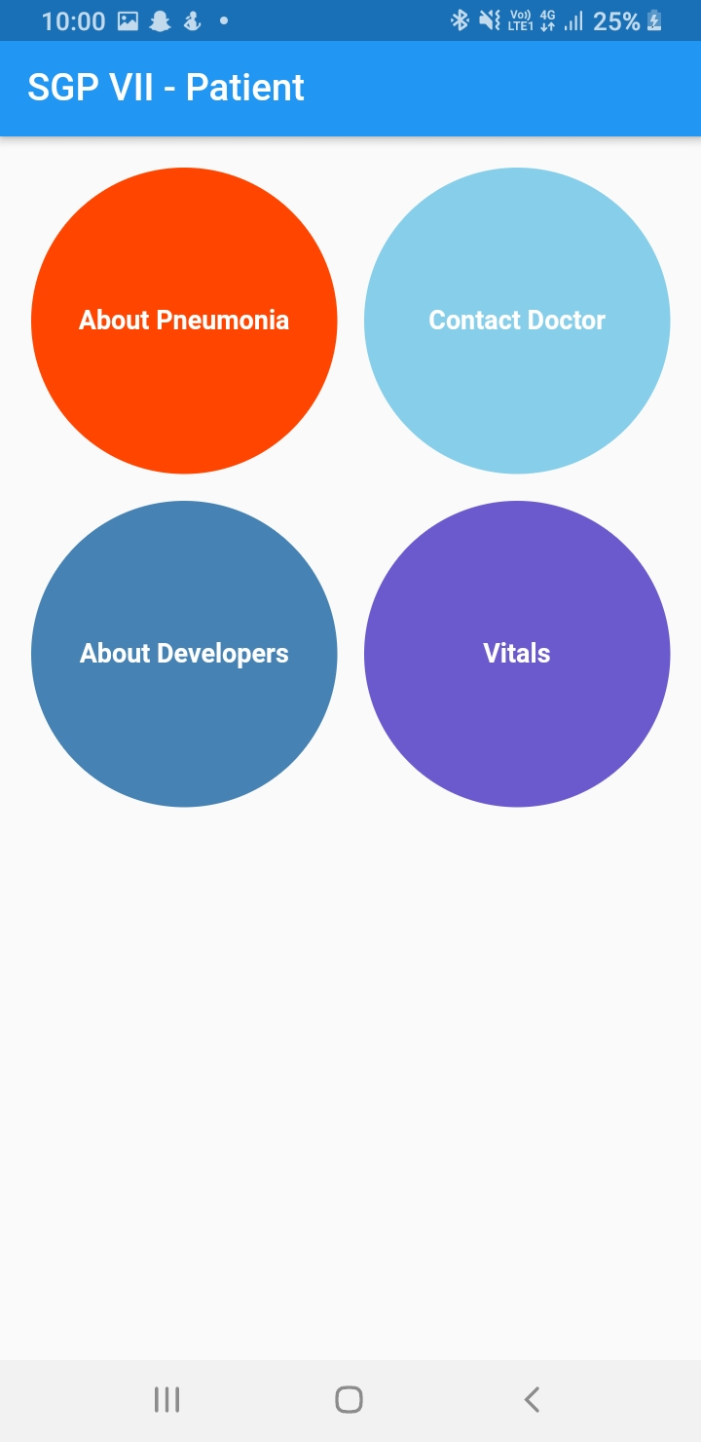
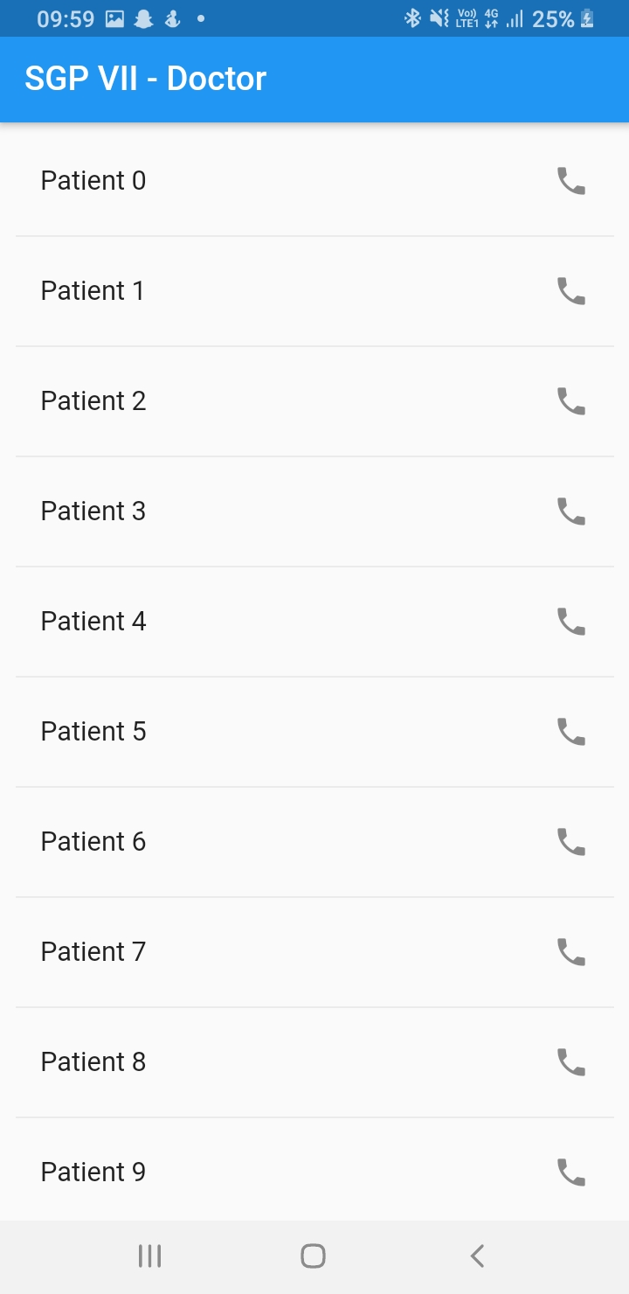
Contd..

Slide 16
Contd..

Slide 17
Contd..

Slide 18
Limitations
Heavy reliability on the swiftness of the sensors
When it comes to hardware, improvement can always be achieved
Future Scope
Making the application industry specific.
Constant improving in User Experience and UI.

Slide 19
Conclusion
This project presents a benchmark in cultivating efforts so as each Doctor as well as Patients can continuously monitor vitals and also track if medication is effective by seeing changes in the various parameters.

Slide 20


